Slide 1

Sales Analytics Project
Kalaiselvi

Slide 2

OVERVIEW
This project focuses on sales analytics for AtliQ Mart, a growing FMCG manufacturer. The objective was to analyze various sales data across different dimensions ( such as products, markets and customers) to generate insightful reports that help the business make informal decisions.

Slide 3

Project Objective
The primary goals of this project were to:
Customer Performance Report
Market Performance vs Target Report
Identify the top 10 products based on the percentage increase in net sales from 2020 to 2021.
Generate a “Division” report to present net sales data for 2020 and 2021, along with the growth percentage.
Rank products to determine the top 5 and the bottom 5 in terms of quality world.
Identify new products that AtliQ Mart began selling in 2021
Determine the top 5 countries by net sales in 2021

Slide 4

Data Source
The analysis was conducted using the following tables:
dim_customer: Contains customer-related information.
dim_marker: Contains market-related information.
dim_product: Contains product-related information.
Fact_sales_monthly: Contains monthly sales data
dim_data: A date dimension table created using power Query
dim_target: Contains target sales data for market performance analysis

Slide 5

Project Workflow
Data Preparation:
Performed ETL (Extract, Transform, Load) operations to clean and structure the data.
Create a dim_date table using Power Query to facilitate time-based analysis.
Connected tables using data modelling techniques in Power Pivot.

Slide 6
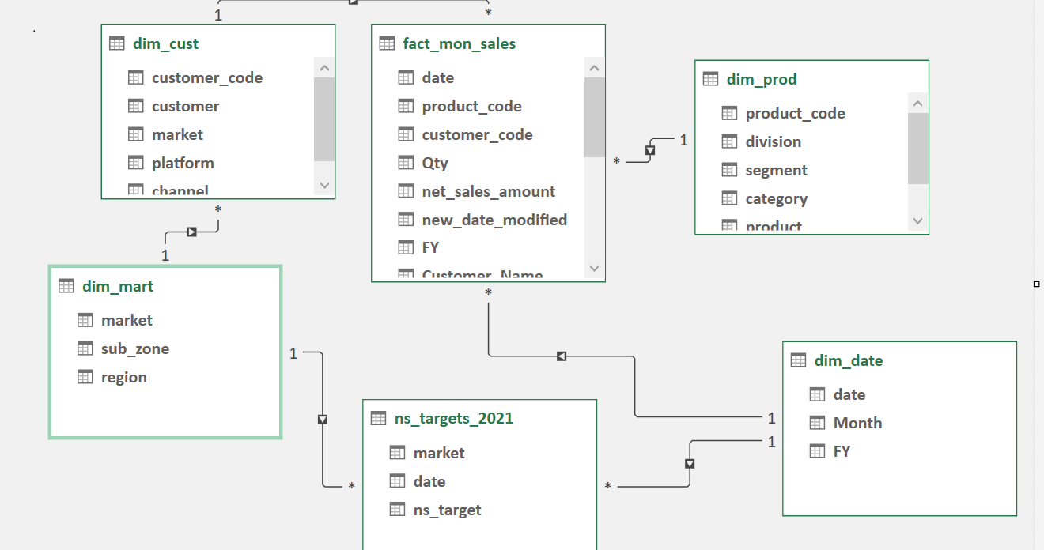
Data Modelling

Slide 7

Project Workflow
Data Analysis
Customer Performance Reports
Generated using data from dim_customer, dim_product, and fact_sales_monthly tables.
Market Performance vs Target Reports: Created using data from dim_market and dim_target tables.
Developed new measures in Power Query to calculate growth percentages, ranking, and identify new product entries.

Slide 8
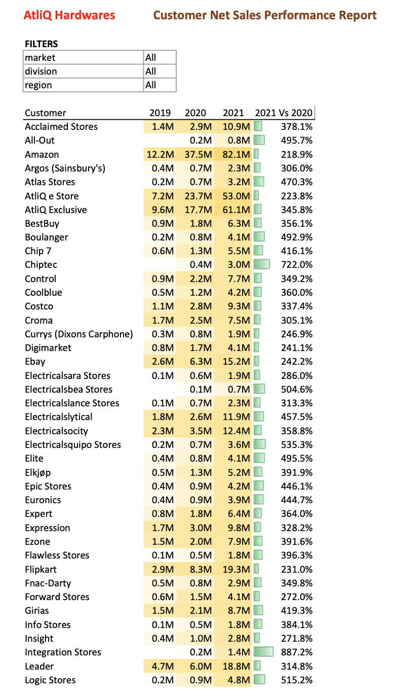
Customer performance report

Slide 9
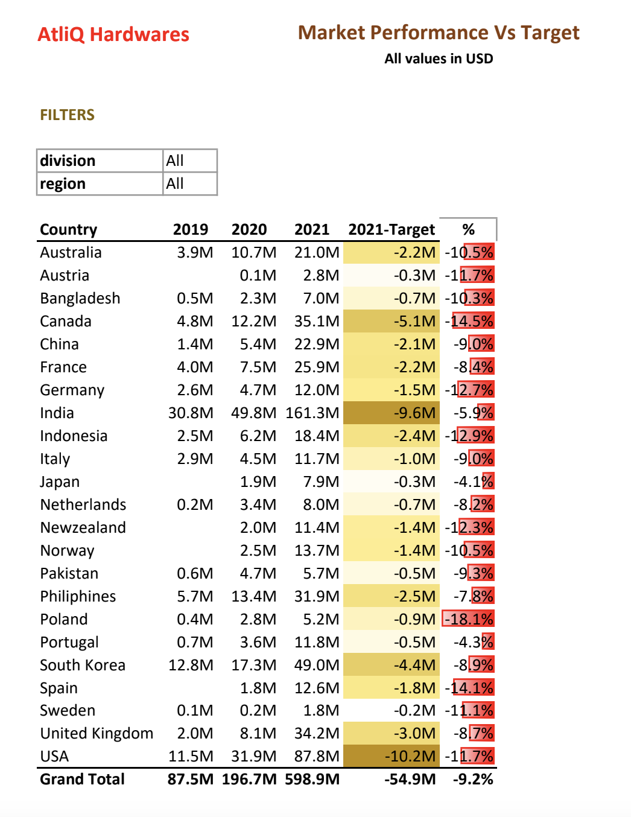
Market Performance vs Target report

Slide 10
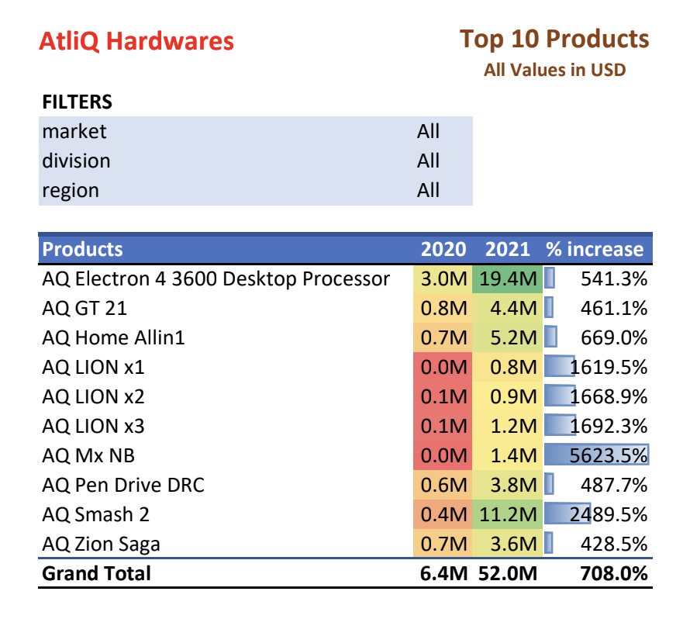
Top 10 products

Slide 11
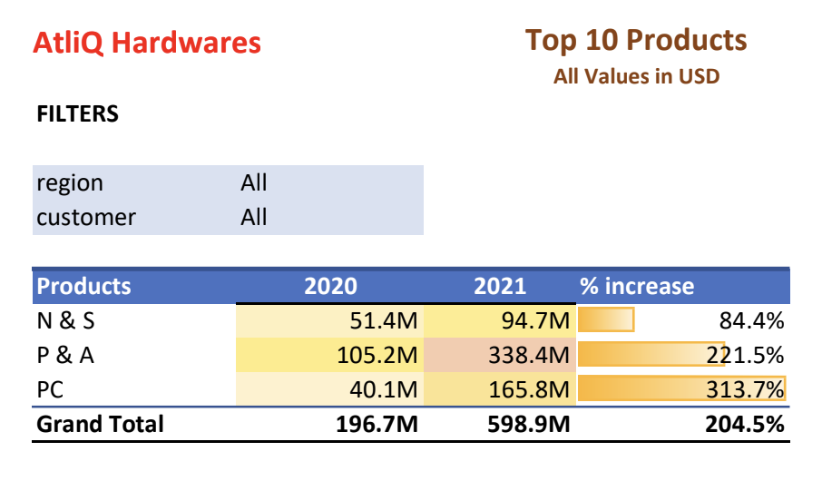
Division Report

Slide 12
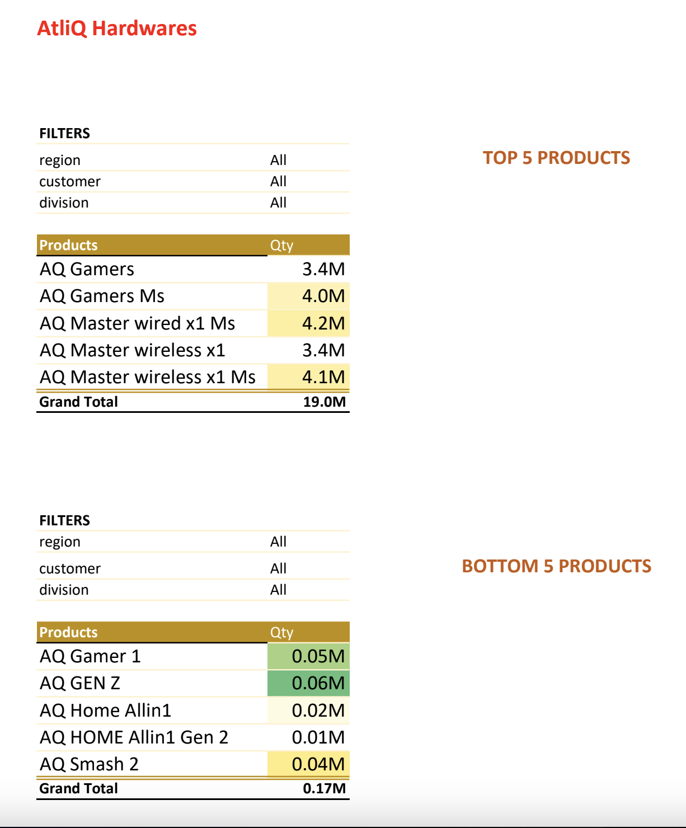
Top & Bottom 5 products

Slide 13
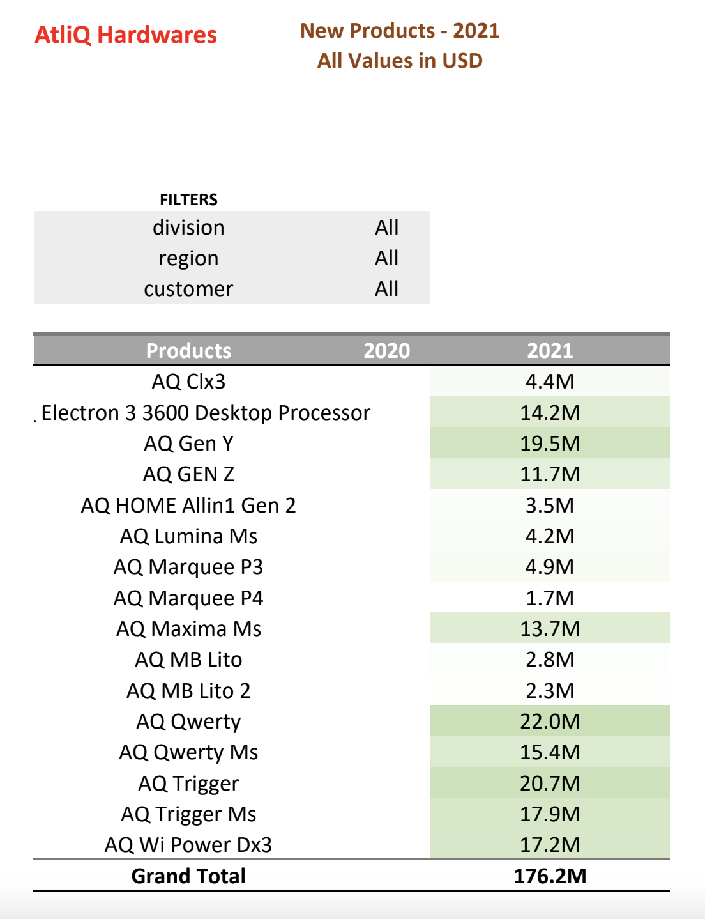
New Products

Slide 14
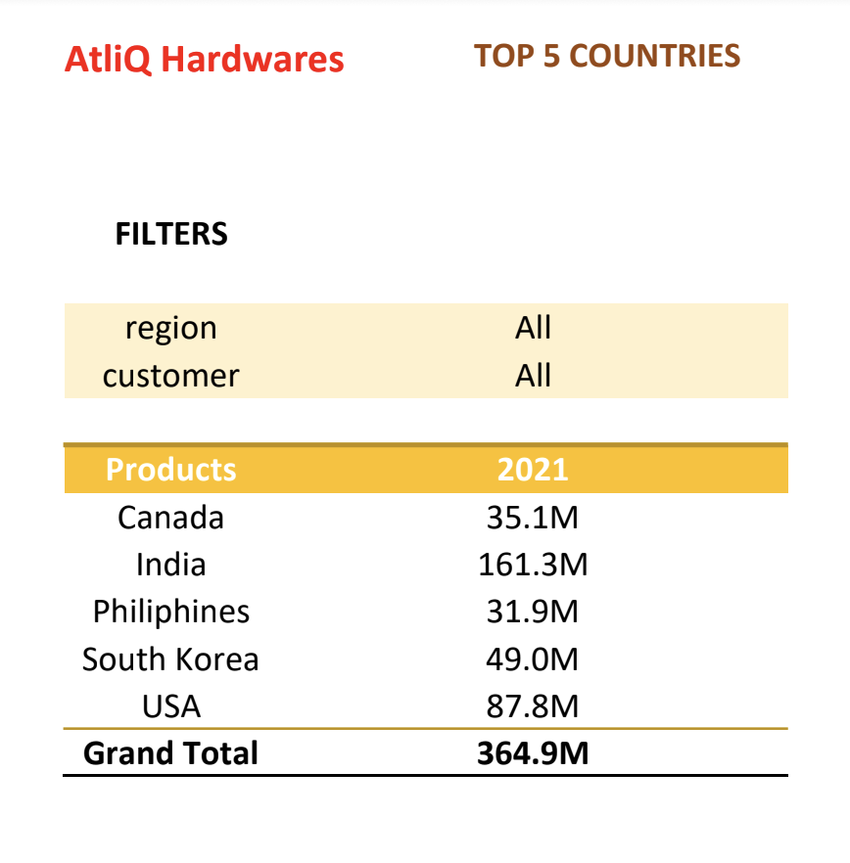
Top 5 countries

Slide 15

Tools and Technologies
Excel: For data cleaning, analysis and report generation.
Power pivot: For data modelling, analysis and report generation.
Power Query: For data transformation and creation of dim_date table.

Slide 16

Results
The reports generated from this project provide insight into product performance, market trends and customer behavior, helping AltiQ Mart to optimize their sales strategy and drive growth.

Slide 17
Conclusion
This project demonstrates how excel can be efficiently used for data analysis and reporting to solve real-world business problems. The insights derived from this analysis enable driven decision-making.

